Slide 1





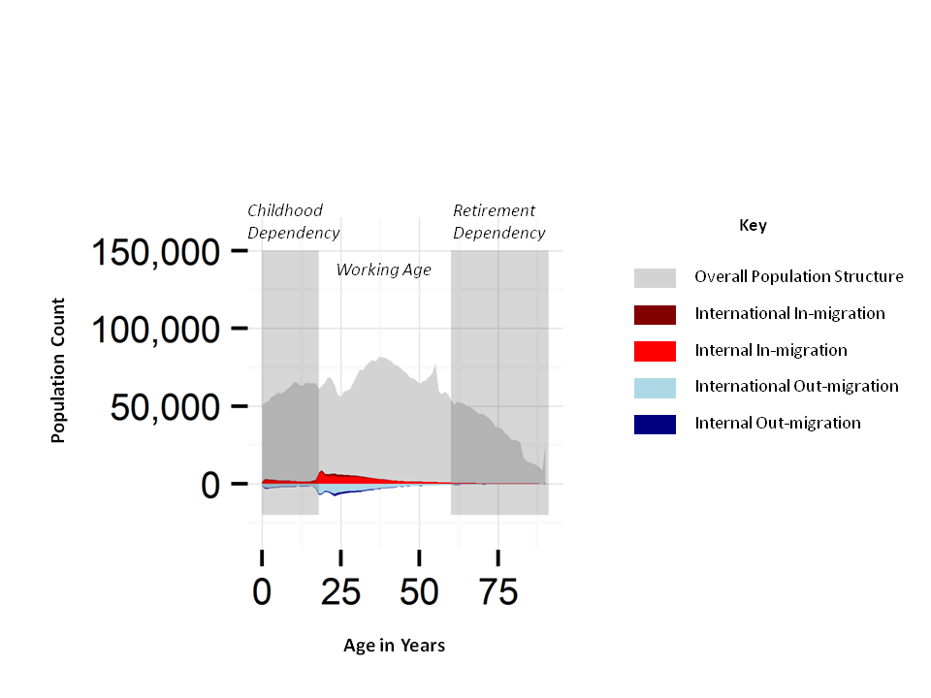
International Migration in the UK
In the context of internal migration & regional population structures
Jon Minton^{b} (AQMeN Urban Segregation & Inequality Project)
ª Urban Studies, School of Social and Political Sciences, University of Glasgow;
International migration in context
International migration remains a political hot topic
UKIP, an anti-immigration party, was able to secure more than four million votes in the 2015 UK General Election.
Conservative government repeatedly promised to reduce international net migration to the ‘tens of thousands’
Since the 2015 election to restrict in-migration flows by renegotiating the UK’s relationship with the EU.
Data Visualisation: Aims & Means
Aim of this research is to use effective data visualisation to understand migration flows and populations in Great Britain, in the context of internal migration, changes over time, population structure.
A ‘data tableau’ is constructed showing how internal migration and international migration contributes to the overall population structure of nine English regions, Wales, and Scotland, for each year from 2002 to 2013.
This data tableau comprises a table of 144 separate figures, each row a region, each column a year, using a consistent aesthetic described below. It should be viewed as an A0 poster.
Data
UK Office for National Statistics and National Records of Scotland Small Area Population Estimates (SAPE) or equivalent for each local authority.
Includes population sizes, and internal and international in-migrations and out-migrations, for each year from 2002 to 2013, and for each single year of age, from birth to 89 years old, with aggregated counts for ages 90 years and above.
Internal migration is defined as any movement originating from and terminating at any local authority in the UK; international migrations are those which originate or terminate outside of the UK over the same period.
The Data Tableau
Legend illustrating one of the 144 tiles in the graphic
Key findings:
London is very different to the elsewhere in terms of international migration profiles, population age profiles, and fertility rates.
North-South Divide: London, the South East, and the South West look like one interdependent country; Scotland, Wales, and other English regions look different to The South, and similar to each other. Only London has substantial international migration compared with population structure.
Main type of migration outside The South seems to be going to university
Conclusions:
Implications:
Two Britains: ‘The North’ and ‘The South’
Scotland and Wales are in ‘The North’
If ‘The South’ has too much international net migration, perhaps ‘The North’ has far too little.
Complex data visualisation tells complex stories.
No single international migration solution as there is no single migration problem.
‘The North’ has a poor demographic profile: ageing and shrinking populations. ‘The South’ is successful largely because of its attractiveness to young adult migrants both internally and internationally.
This work was funded by the Economic & Social Research Council through the Applied Quantitative Methods Network: Phase II, grant number ES/K006460/1.
Contact: Dr Jon Minton, nate.minton@gmail.com

